Slide 1
Oracle Database Vault
Nguyễn Lê Vĩnh
Trần Lương Khiêm

Slide 2
Outline
Introduction
Oracle Database Vault
Demo
Conclusion

Slide 3
Outline
Introduction
Oracle Database Vault
Demo
Conclusion

Slide 4
Introduction
Attacks on databases are becoming increasingly
Internal threats
Business requirements
Separation of users’ duty
...
Notes:
Internal threats are a much bigger concern today require enforcement of operational security policies - Who, When, Where can data be accessed?
Database consolidation strategy requires preventive measures against access to application data by Powerful (DBA) users
I have requirements around SOX and PCI, how can I prevent my DBA from looking at the application data, including Credit Cards and Personal Information?
No protection from users with DBA privileges
DBA role with full access to user and business data
Only few apps built with least-privilege model:
various utilities require powerful administrator privileges
Cannot meet new compliance requirements:
separation of duty not enforced
Cannot control user creation, role assignment, etc.

Slide 5
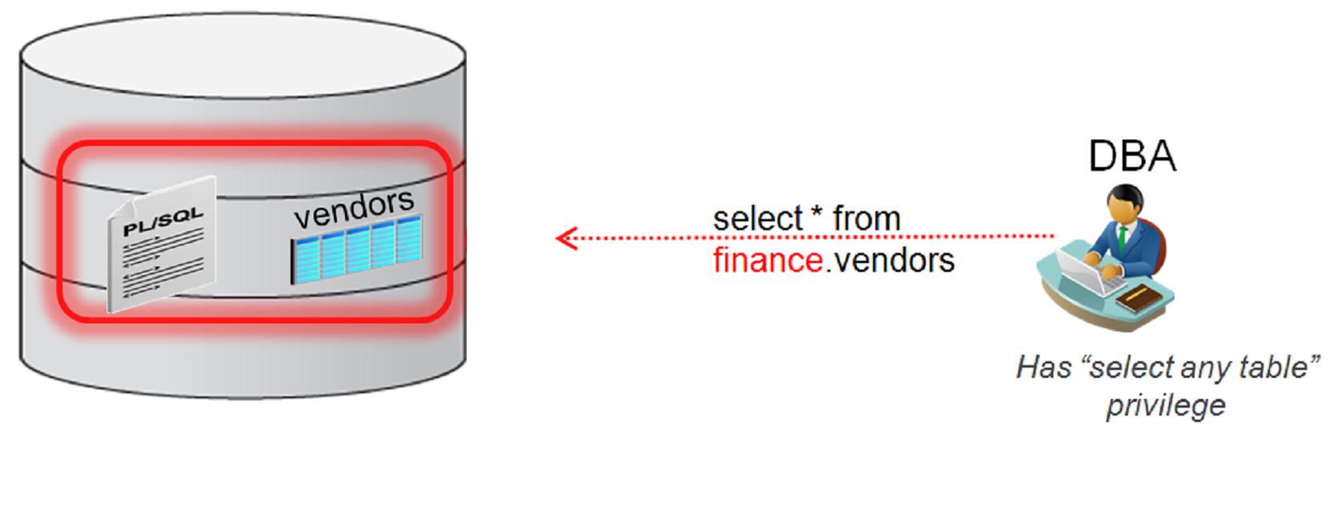
Introduction (cont.)

Slide 6
Outline
Introduction
Oracle Database Vault
Conclusion
Demo

Slide 7
Oracle Database Vault
Oracle Database Vault reduces the risk of insider and outsider threats and addresses common compliance requirements by:
Preventing privileged users (DBA) from accessing sensitive application data
Preventing compromised privileged users accounts from being used to steal sensitive data or make unauthorized changes to databases and applications
Providing strong controls inside the database over who can do what and controls over when and how applications, data and databases can be accessed
Providing privilege analysis for all users and applications inside the database to help achieve least privilege model and make the databases and applications more secure
Notes:
Controls for Privileged Accounts
Controls for Database Configuration
Enterprise Applications Protection Policies
Run-time Privilege Analysis for Users and Applications
Protecting against insider threat from highly privileged
Authentication based on context

Slide 8
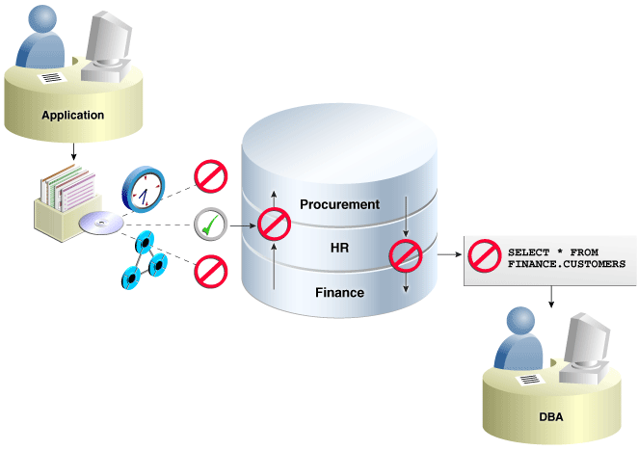
Oracle Database Vault (cont.)

Slide 9
Oracle Database Vault Components
Access Control Components
Manager Cloud Control Database Vault Administrator Pages
DVSYS and DVF Schemas
PL/SQL Interfaces and Packages
Reporting and Monitoring Tools

Slide 10
Oracle Database Vault Access Control Components
Realms
Command Rules
Rule Sets
Factors
Secure Application Roles

Slide 11
Realms
Collections of schemas, objects and roles to be secured
Controls SELECT, DML, DDL, EXECUTE on protected objects
Prevents super user (ANY) access to security sensitive data
Does not impact direct object privileges
Realm owner determines:
Who can access the realm using system privileges
Grants/revokes applicable roles
Authorization enforced at every data object access during SQL execution
Notes:
System vs. Object Priv: http://docs.oracle.com/cd/E13085_01/doc/timesten.1121/e13070/privileges.htm

Slide 12
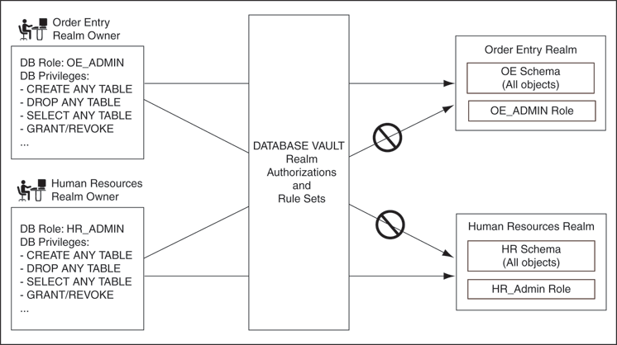
Realms

Slide 13
Command Rules
A command rule is a rule which protects SELECT, ALTER SYSTEM, database definition language (DDL), and data manipulation language (DML) statements that affect one or more database objects.
Works very similar to DDL event triggers
Built into the SQL engine for optimization and security
Cover all basic DDL and DML commands
Command
Object
Owner
Rule Set
Command rule attributes

Slide 14
Rule Sets
A rule set is a collection of one or more rules that you can associate with a realm authorization, command rule, or secure application role…
Evaluation type: All True or Any True
Examples:
Allow updates to the database structure only on the weekend
Users can only access tables in official working hours

Slide 15
Factors
A factor:
Is an attribute of a database session
Can have a value, which can be labeled as an identity
Can easily be referenced in other Database Vault components to discern access
Can be combined with other factors to provide for multi-factored authentication

Slide 16
Factor Examples
User Factors:
Name
Authentication type
Session User
Network Factors:
Machine name
Client IP
Network Protocols
Database Factors:
Database IP
Database Instance
Database Hostname
Runtime Factors:
Language
Date
Time

Slide 17
Secure Application Roles
Oracle Database secure application roles are enabled by custom PL/SQL procedures
Secure application roles can prevent users from accessing data from outside an application. This forces users to work within the framework of the application privileges that have been granted to the role.

Slide 18
Database Vault Access Workflow
Data Access Protected by DV?
Y
Exercising System Privileges?
Y
Realm Authorization
N
BLOCK
N
N
Y
N
Command Rules
Y
ALLOW

Slide 19
Outline
Introduction
Oracle Database Vault
Demo
Conclusion

Slide 20
Demo
Configuring Oracle Database Vault Access Control Components

Slide 21
Demo
Context
Expectation
Oracle 12c
DBA can query sensitive data of Human Resource Department
Turn on the Oracle Database Vault
Using Realm technique on the HR schema
=> DBA can not access to the data anymore

Slide 22
Outline
Introduction
Oracle Database Vault
Demo
Conclusion

Slide 23
Conclusion
Oracle Data Vault solution

Slide 24
References
Kamal Tbeileh, Oracle Database Vault with Oracle Database 12c, Oracle, 2013
Patricia Huey, Oracle® Database Vault Administrator's Guide 12c Release 1 (12.1), Oracle, 2014

Slide 25
Q&A

